Slide 1
GPU and (Async)Solvers for Physics-based simulations
Hadrien Courtecuisse

Slide 2
1
Overview and theoretical bases
2
GPU parallelization and Cuda
3
Preconditioners and asynchronous solvers
4
Asynchronous solvers for contact
Applications
5

Slide 3
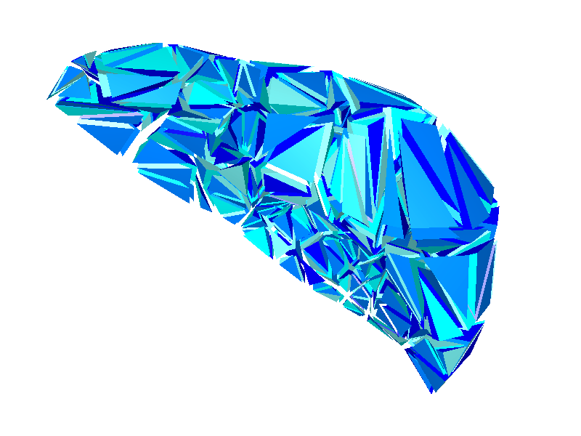
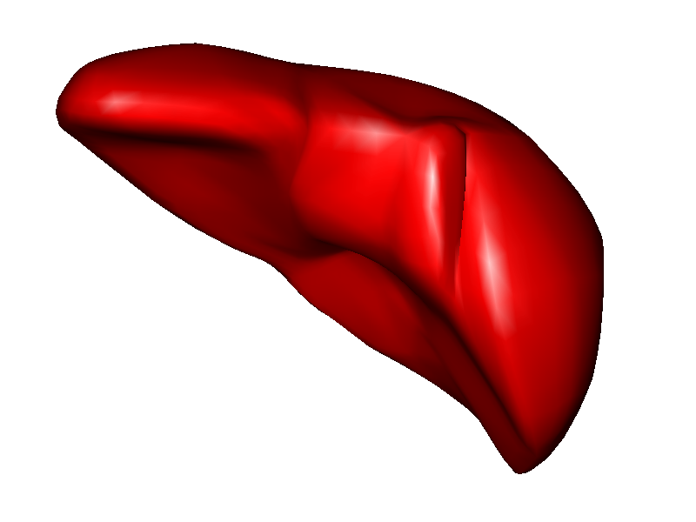
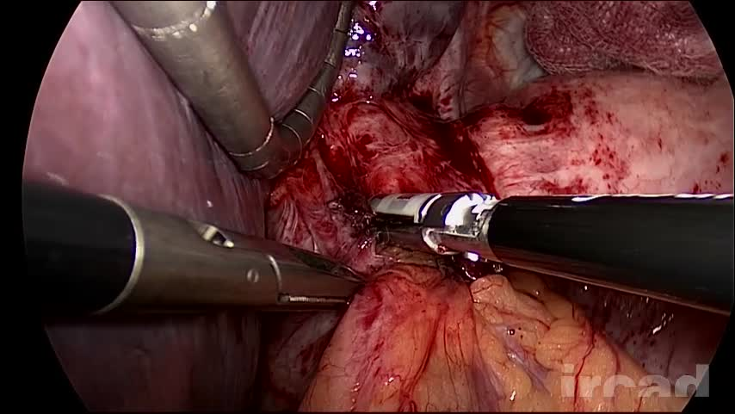
Equations formulation
Continuum mechanics
Assumption of continuity of matter
Based on physics law
Define a deformation model
$$ε=f(σ)$$
$$σ$$
Constitutive law
$$ε$$
$$σ=f^{−1}(ε)$$
Solution based on finite element method
Discretization in small elements
Integrate and solve equations by elements
Approximation which depends on the size of elements
Stress
Solution of a dynamic system :
Time evolution of deformable bodies
Involves acceleration, velocity, and position
Strain

Slide 4
Real time : definition
Real-time simulation : all the computations done in 1 time step, are done in a time equal to the time step
t
t+dt
t+1sec
Simulation time
dt
t
t+1sec
User time (real)
The number of Frame Per Second (FPS) times dt must be equal to 1 second.

Slide 5
Real time : definition
Simulation too fast:
t
t+dt
t+1sec
t+1sec
Simulation time
dt
t
t+1sec
User time (real)
Slow down the simulation with a waiting loop

Slide 6
Real time : definition
Simulation too slow :
t
t+dt
t+1sec
Simulation time
dt
t
t+1sec
User time (real)
Record the images of the simulation, and play them faster to reach real time.
Impossible when the user interact with the simulation !

Slide 7
Why do we need real-time ?
Synchronize the simulated instruments with the simulated bodies
Slow down the motion of the instruments in the simulation
Difficult (impossible) to use for a surgeon
Delay when applying haptic forces
Deformable
structure
Real motion
Simulation

Slide 8
Why do we need real-time ?
Synchronize the simulated instruments with the user motion
The velocity of the instruments is faster than other deformable structures
Important error introduced during the interaction
Structure déformable
Deformable
structure
Real motion
Simulation

Slide 9
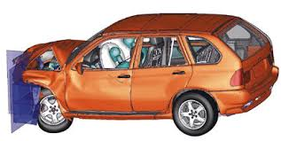
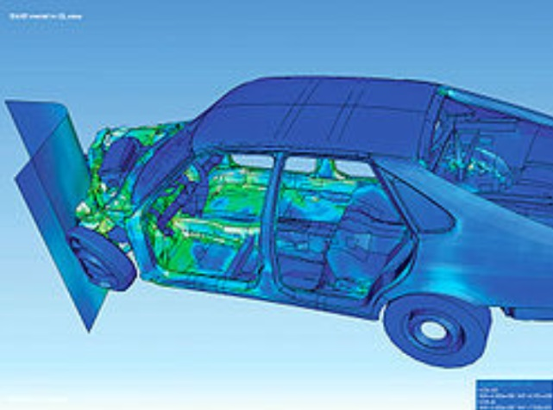
Why do we need real-time ?
Crash test example :
The velocity has a huge impact on the resulting deformation
Delay in the simulation introduce important errors !

Slide 10
Real time : definition
Additional constraints :
A frame rate of at least 60 FPS is necessary to have a visual fluidity
Less than 20 ms to process all the computations (computation of the deformation, collision detection, contact force response, rendering, …)
Interactive simulation :
A simulation which is not slower than real time but fast enough to allow user interactions
At least 10 FPS
Simulation with haptic feedback
Haptic requires at least 1Khz to simulate a smooth force feedback, ant stiff interactions
Les than 1 ms to update haptic forces
Accuracy ?
It’s relatively easy to simulate very fast with very simplified models
Find a tradeoff between accuracy and computation time

Slide 11
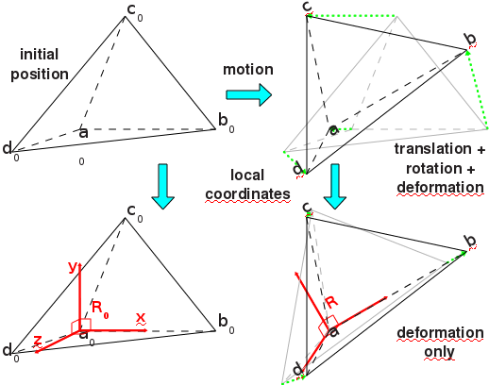
Interactive deformation model
Small displacements and small deformations :
Linear constitutive law
Simple and fast
Inflates for large deformations/displacements
Co-rotational
FEM
Linear
FEM
Large displacements and small deformations :
Compensate geometrical non linearity
Take into account the rotations / linear deformation
Co-rotationnal model : TetrahedronFEMForceField
$$K= \sum{G_{e}∗R_{e}∗K_{e}∗{K_{e}^{}}_{}^{T}∗{G_{e}^{}}_{}^{T}}$$
Large displacements and large deformations :
Simulation of large deformation
Hyperelastic model :
MJED [Marchesseau et al. 2010]
TLED [Comas et al. 2008]
Difficult to solve in real time
$$σ$$
$$ε$$

Slide 12
Temporal system evolution
Explicit integration :
Local resolution
Fast and parallelizable
Stability implies to use very small time steps
$$f(p_{t},v_{t})$$
$$f(p_{t+h},v_{t+h})$$
$$Ma =$$
$$v_{t+h}= v_{t}+ha$$
$$p_{t+h}= p_{t}+hv_{t+h}$$
Implicit integration :
Update the acceleration from position and velocity at the end of the time step
Stable with large time steps
Linearization of $f$ around the initial position [Baraff et al. 1998]
$$f\left(p_{t+h},v_{t+h}\right)=f\left(p_{t},v_{t}\right)+K∙\left(p_{t+h}−p_{t}\right)+B∙(v_{t+h}−v_{t})$$
Rearranging equations gives the linear system :
$$\left(M−hB−h^{2}K\right) dv=hf\left(p_{t},v_{t}\right)+h^{2}Kv_{t}$$
$$A x = b$$

Slide 13
1
Overview and theoretical bases
2
GPU parallelization and Cuda
3
Preconditioners and asynchronous solvers
4
Asynchronous solvers for contact
Applications
5

Slide 14
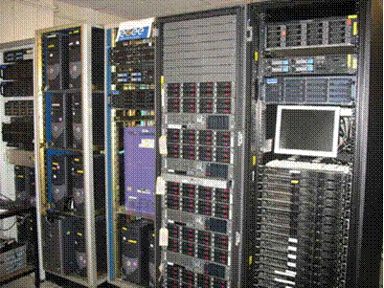
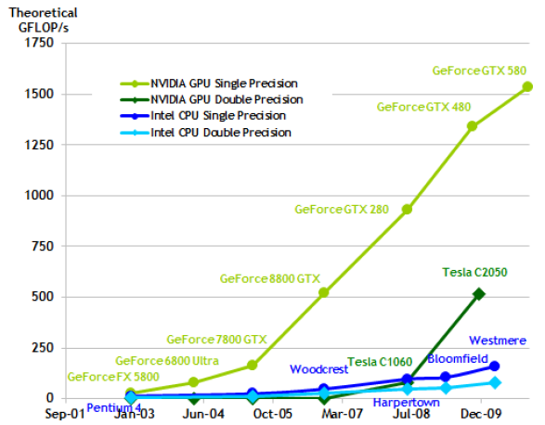
New parallel architectures
Difficult to increase the frequency of processors
Heat dissipation
Electric consumption
Parallelization of algorithms
Parallelization of a simulation is not a new idea :
Parallel processors, distributed processors, …
Real time simulation constraints :
A lot of very fast computations
Use GPU to achieve computations (GPGPU).
GPU is very different than CPU parallelization.
Run thousand of threads to exploit efficiently the GPU
GPU is seen as a specialized co-processeur :
Achieve high parallel tasks

Slide 15
GPU architecture
GPU is seen as a specialized co-processeur :
Achieve high parallel tasks
CPU
GPU
Grille 1
Kernel 1
Block
(0,0)
Block
(1,0)
Blobk
(2,0)
Two level of parallelism :
A Grid contains several blocs
A Block contains several threads
Block
(0,1)
Block
(1,1)
Block
(1,2)
GPU programing :
Local synchronisations very fast
Global synchronisations very slow (Synchronisation with the CPU)
Kernel 2
Grille 2
Block (1,1)
Thread
(0,0)
Thread
(1,0)
Thread
(2,0)
Thread
(3,0)
Thread
(4,0)
Run thousand of threads of threads to exploit efficiently the GPU !
Thread
(0,1)
Thread
(1,1)
Thread
(2,1)
Thread
(3,1)
Thread
(4,1)
Thread
(0,2)
Thread
(1,2)
Thread
(2,2)
Thread
(3,2)
Thread
(4,3)

Slide 16
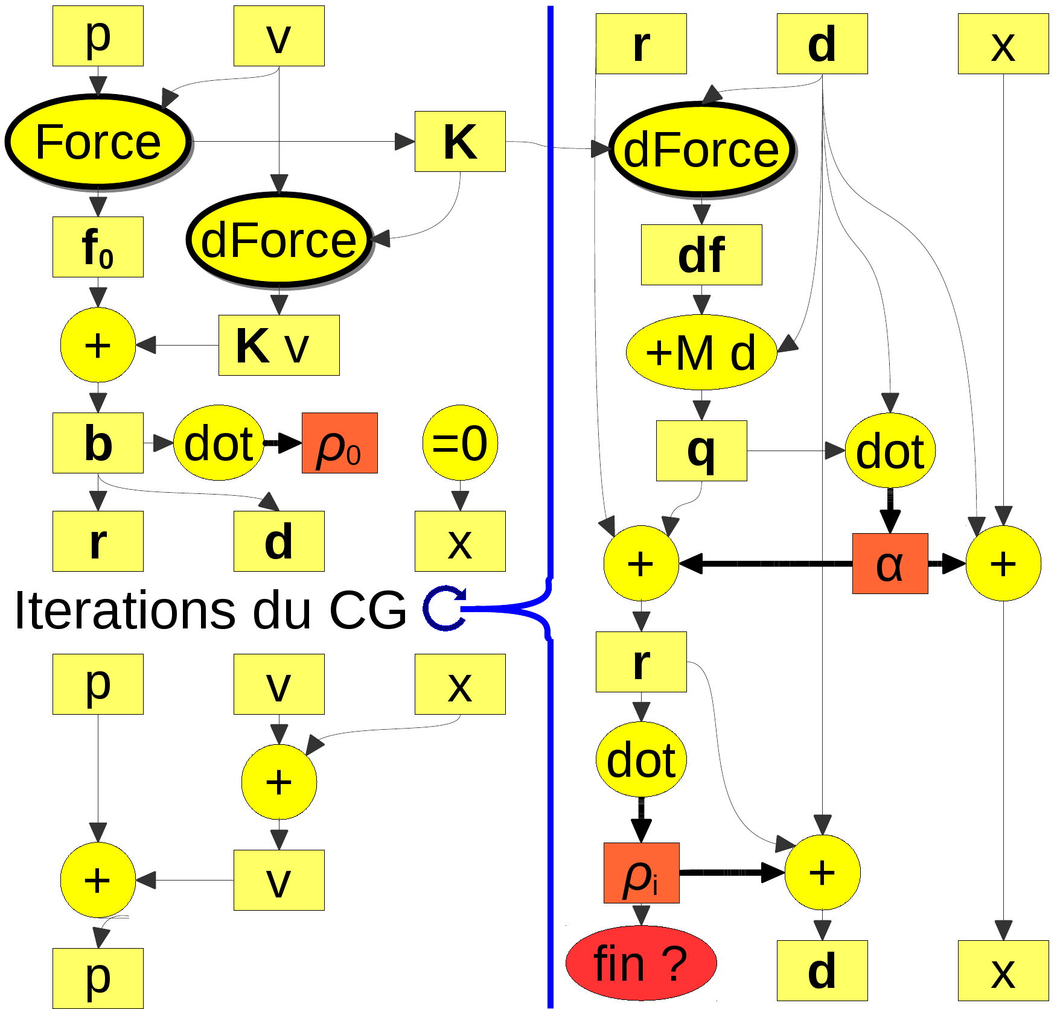
GPU-based implicit integration
Parallelization of implicit integration [Allard et al. 2011, GPU Gems]
Only two scalar and must be transferred between CPU and GPU to check convergence
$$α$$
$$ρ_{i}$$
Most of operations and are linear algebra operations
Parallelization solutions exists
+
dot
Only and are not linear algebra operations
Accumulate forces on each DOF
$\left(M−hB−h^{2}K\right) dv=hf\left(p_{t},v_{t}\right)+h^{2}Kv_{t}$
Force
dForce
GPU
CPU

Slide 17
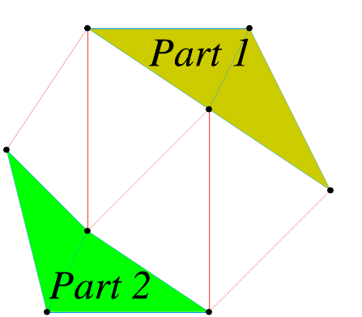
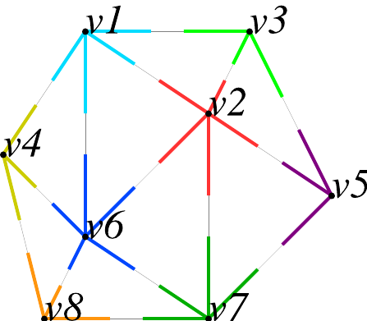
Implicit solver on GPU
Accumulate forces on each points
Independent of the deformation model
Dependences between edges
Parallelization methods :
Graph partitioning [Hermann et al. 2010]
Small number of processors
Graph coloration [PhysX, Bullet]
Graph very sparse, analysis of the graph
Treat each DOF in parallel
Assign an unique ID to each edge
Pre-compute neighbourhood associations
Require one global synchronisation
0
4
Kernel1
1
2
3
Temporary vector :
Synchronisation
Kernel2
Precomputed vector of neighborhood :
$$\overset{Noeuds 0}{\overbrace{\begin{matrix}0 & 3 & 6\end{matrix}}}$$
$\overset{Noeuds 1}{\overbrace{\begin{matrix}1 & −1 & −1\end{matrix}} }$
$\overset{Noeuds 2}{\overbrace{\begin{matrix}2 & 4 & −1\end{matrix}} }$
$\overset{Noeuds 3}{\overbrace{\begin{matrix}5 & 7 & −1\end{matrix}} }$
$$\overset{Noeuds 4}{\overbrace{\begin{matrix}8 & −1 & −1\end{matrix}}}$$

Slide 18
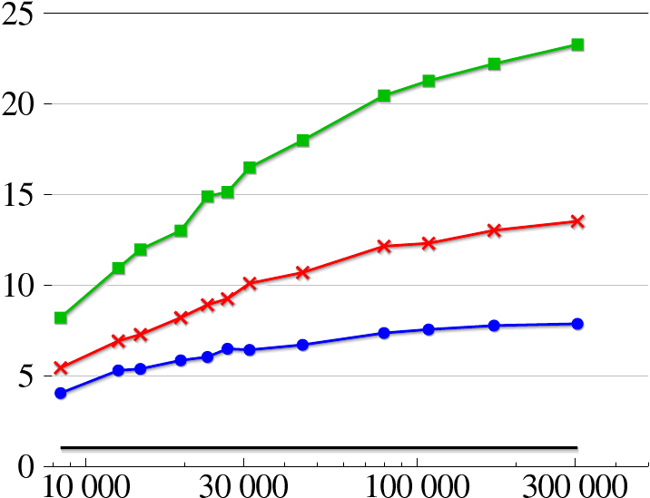
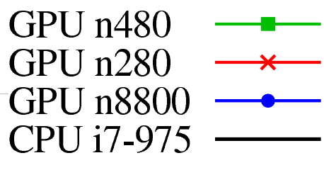
Performances evaluation
Speedup between 5 to 25
Simulate 300 000 elements in real time (CG limited to 25 iterations)
Nombre
Speedup
Number of elements

Slide 19
1
Overview and theoretical bases
2
GPU parallelization and Cuda
3
Preconditioners and asynchronous solvers
4
Asynchronous solvers for contact
Applications
5

Slide 20
Asynchronous preconditioner
GPU-Base Conjugate gradient :
Simulate thousand of elements in real-time
High number of iterations for ill conditioned problems
Non homogeneous objects / Non uniform meshes

Slide 21
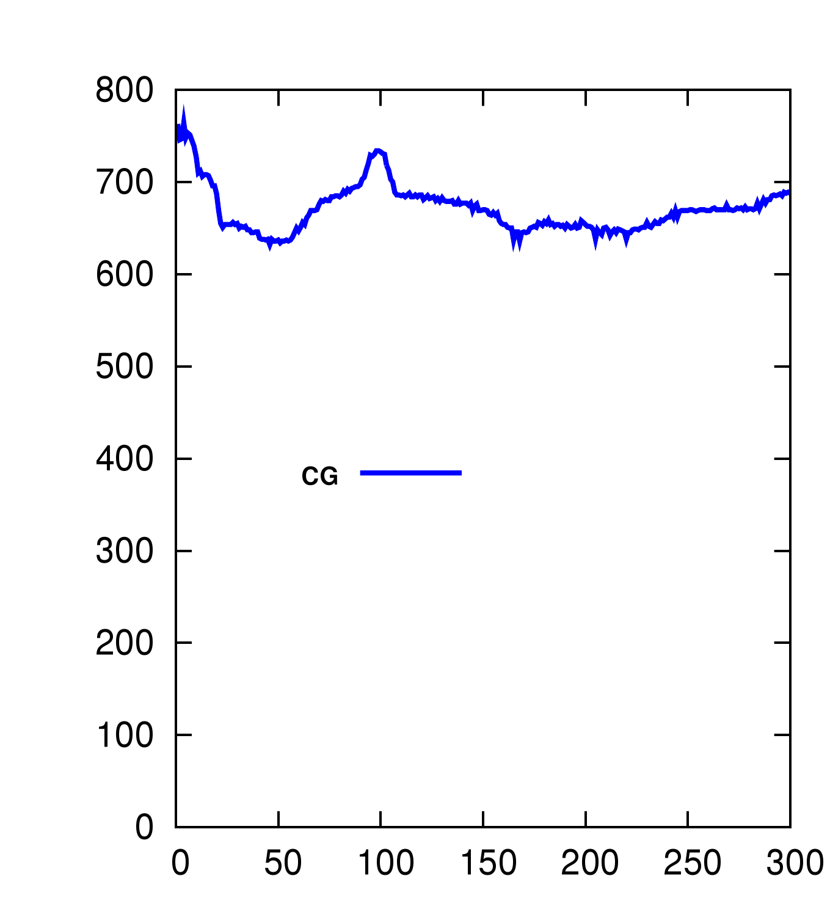
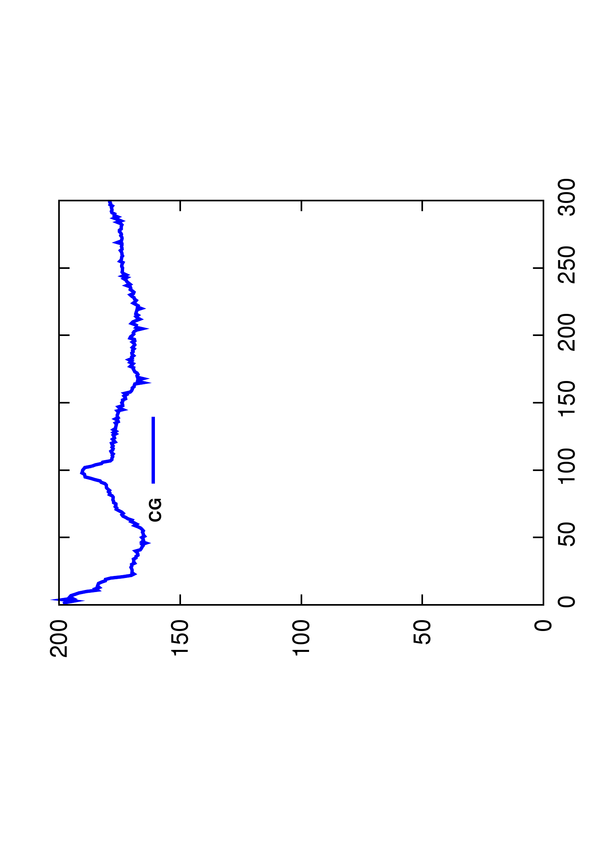
Asynchronous preconditioner
Number of iterations
Computation time (ms)

Slide 22
Asynchronous preconditioner
GPU-Base Conjugate gradient :
Simulate thousand of elements in real-time
High number of iterations for ill conditioned problems
Non homogeneous objects / Non uniform meshes
Use a preconditioner :
Approximation of the system which is easier to invert
New FEM Computation
Precond
Computation
$$A x=$$
$$b$$
$P^{−1} P^{−1}$
$$≈I$$
CG
Iterations
Fast convergence with additional overheads
Overhead to inverse the preconditioner
Overhead to apply the preconditioner at each iteration
Precond
Application

Slide 23
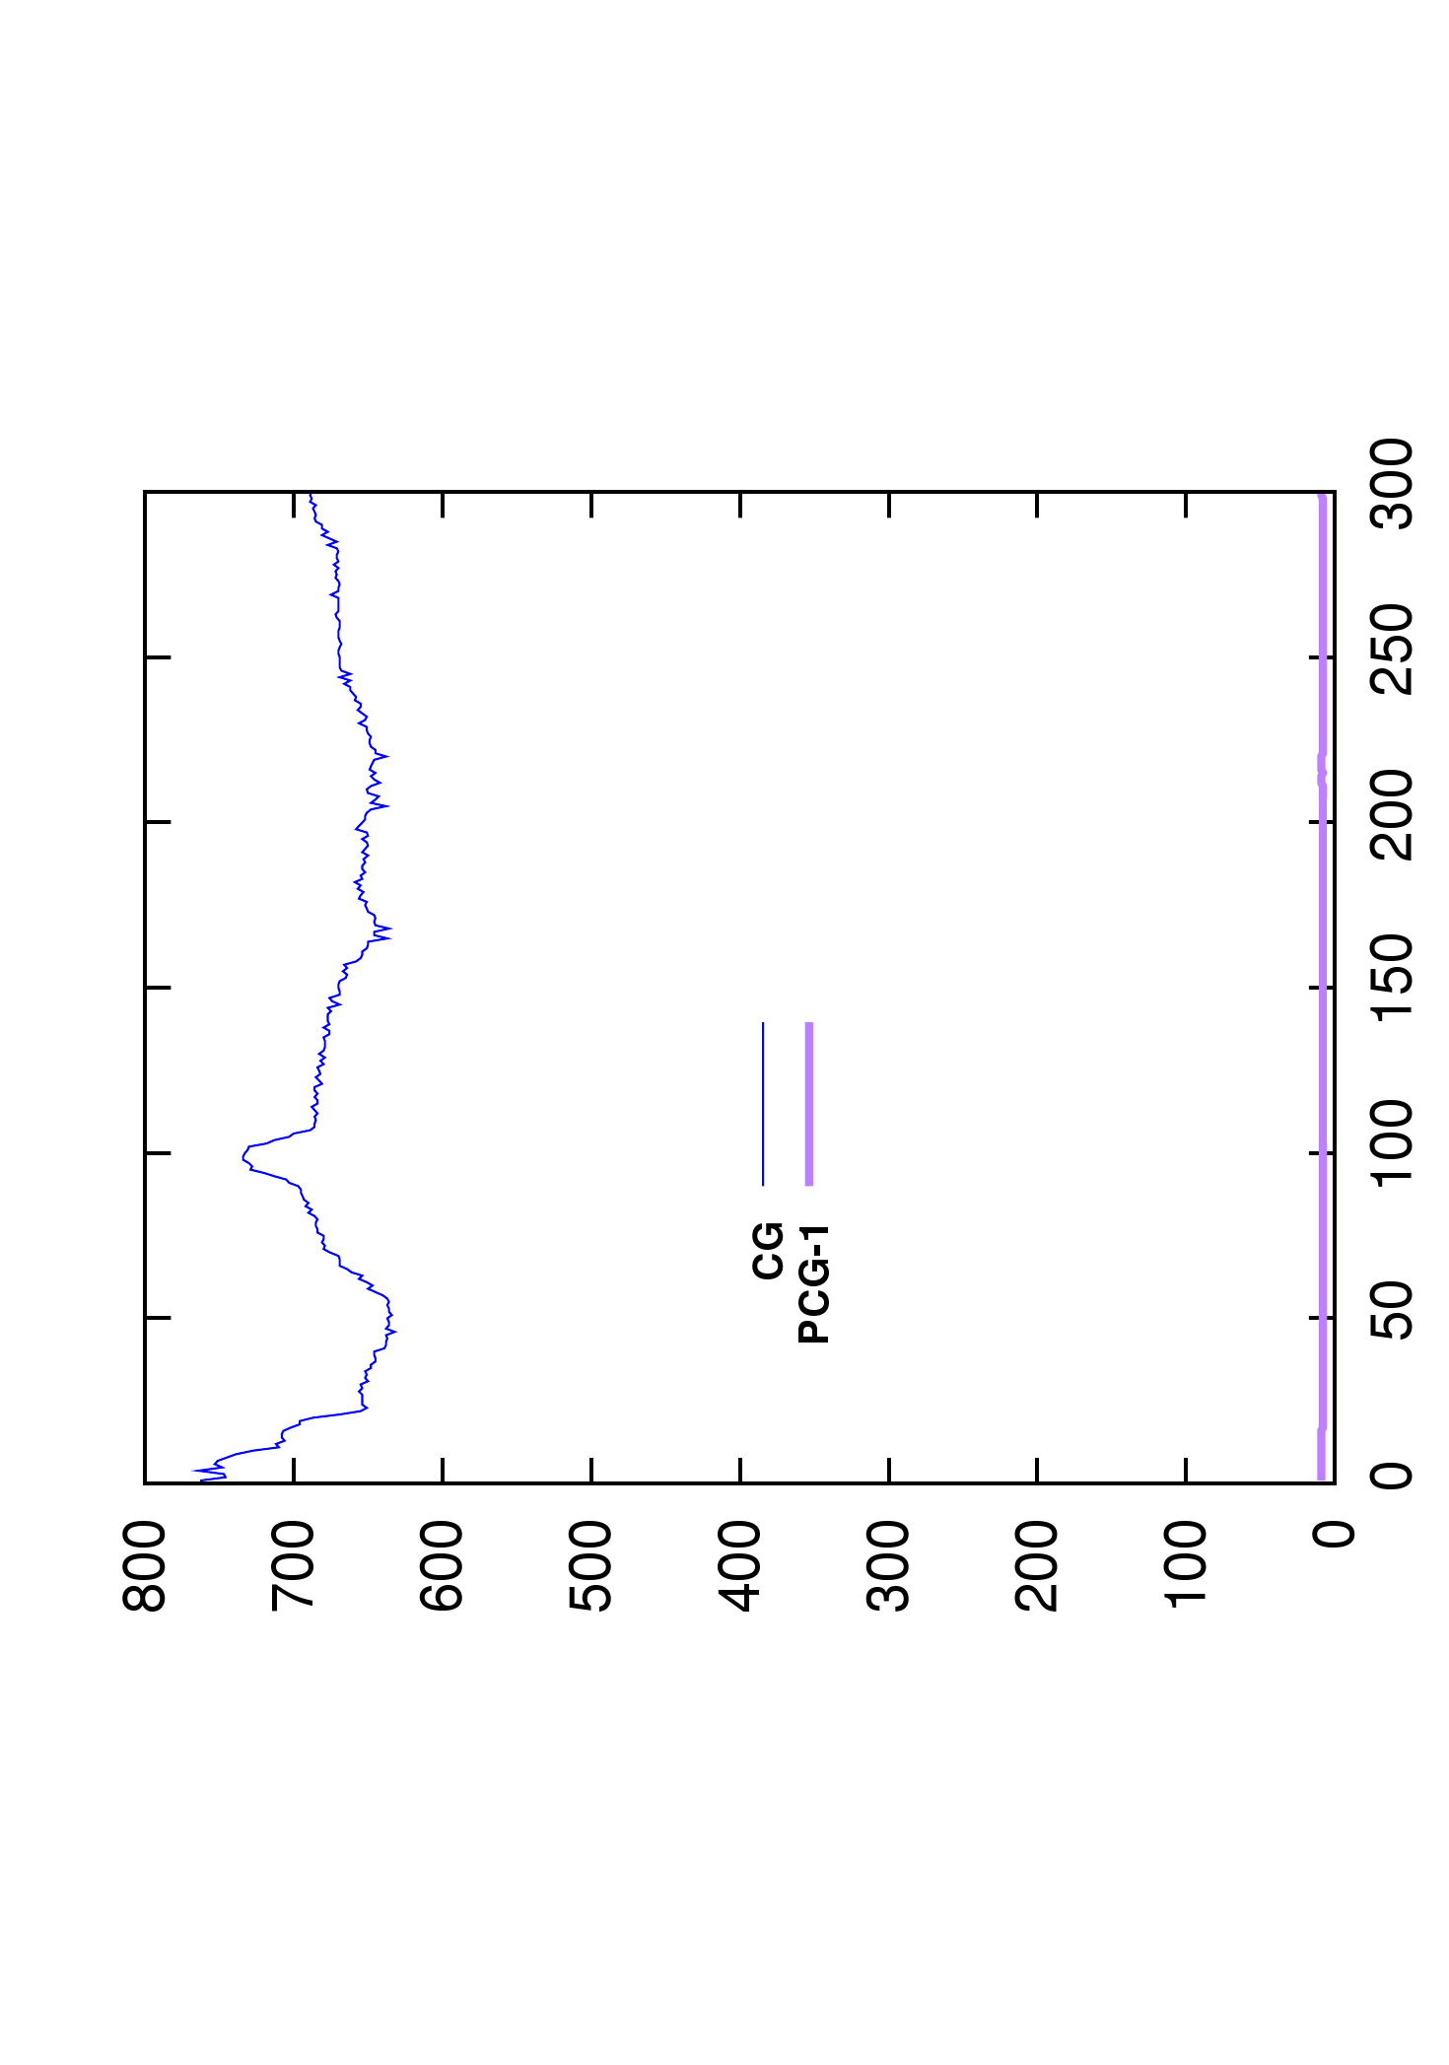
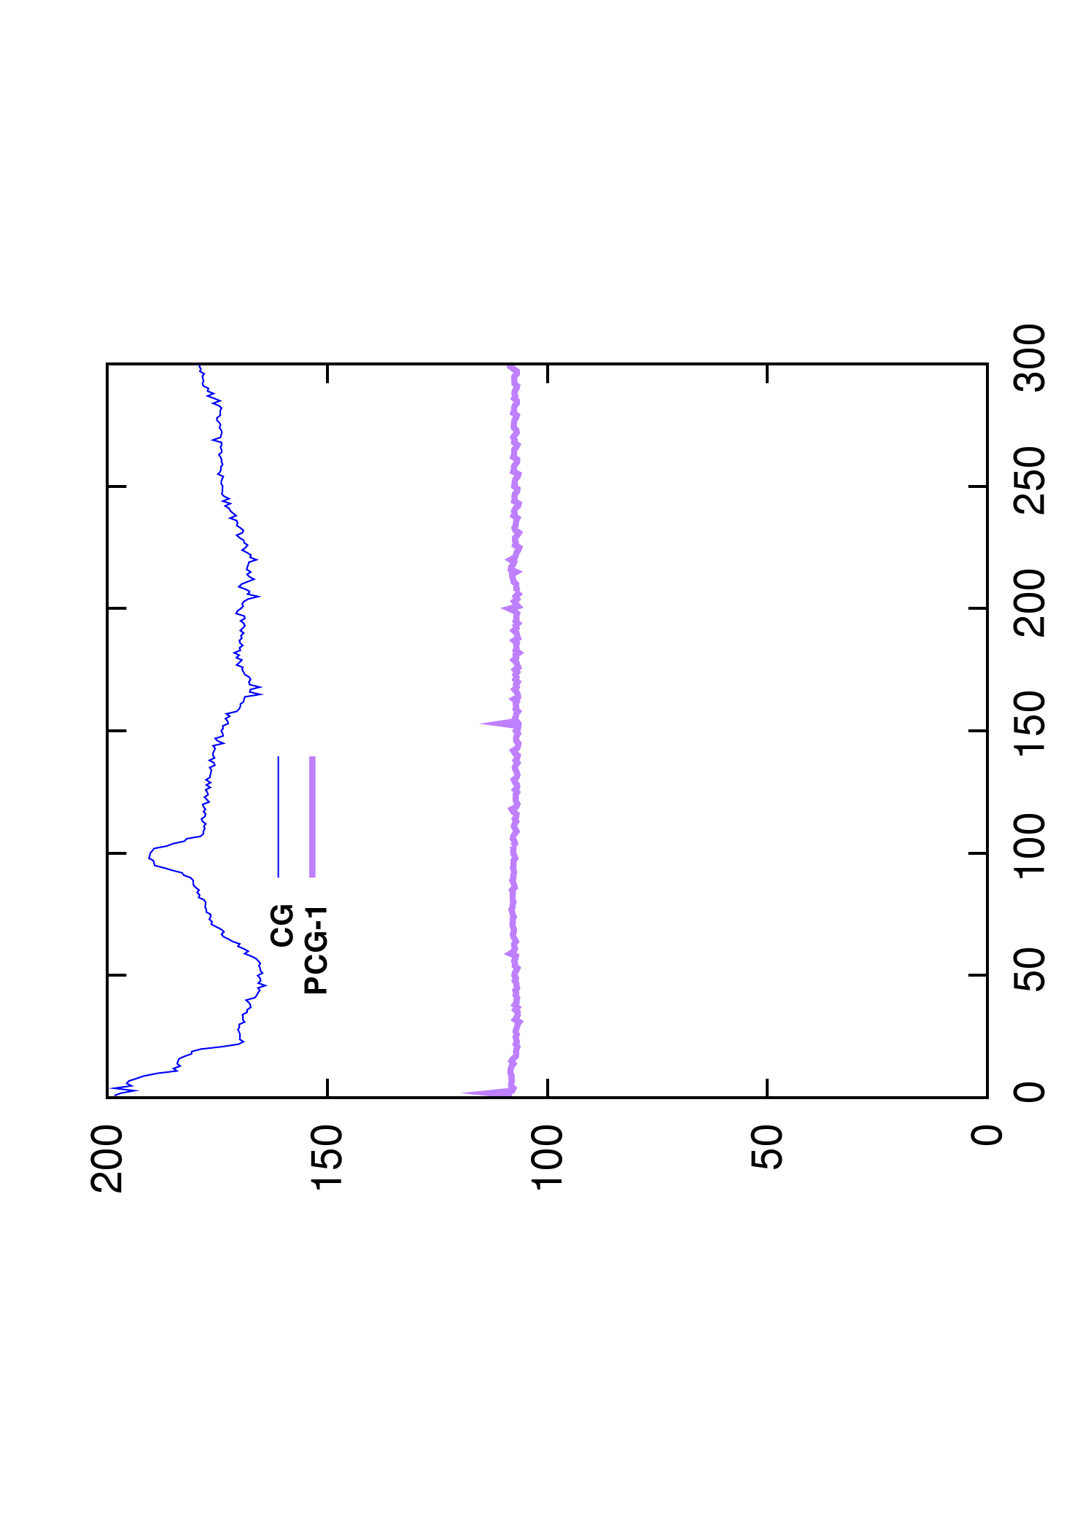
Asynchronous preconditioner
Number of iterations
Computation time (ms)

Slide 24
Asynchronous preconditioner
GPU-Base Conjugate gradient :
Simulate thousand of elements in real-time
High number of iterations for ill conditioned problems
Non homogeneous objects / Non uniform meshes
Use a preconditioner :
Approximation of the system which is easier to invert
New FEM Computation
Precond
Computation
$$A x=$$
$$b$$
$P^{−1} P^{−1}$
$$≈I$$
Fast convergence with additional overheads
Overhead to inverse the preconditioner
Overhead to apply the preconditioner at each iteration
Exploit time coherency between time steps
CG
Iterations
Precond
Application

Slide 25
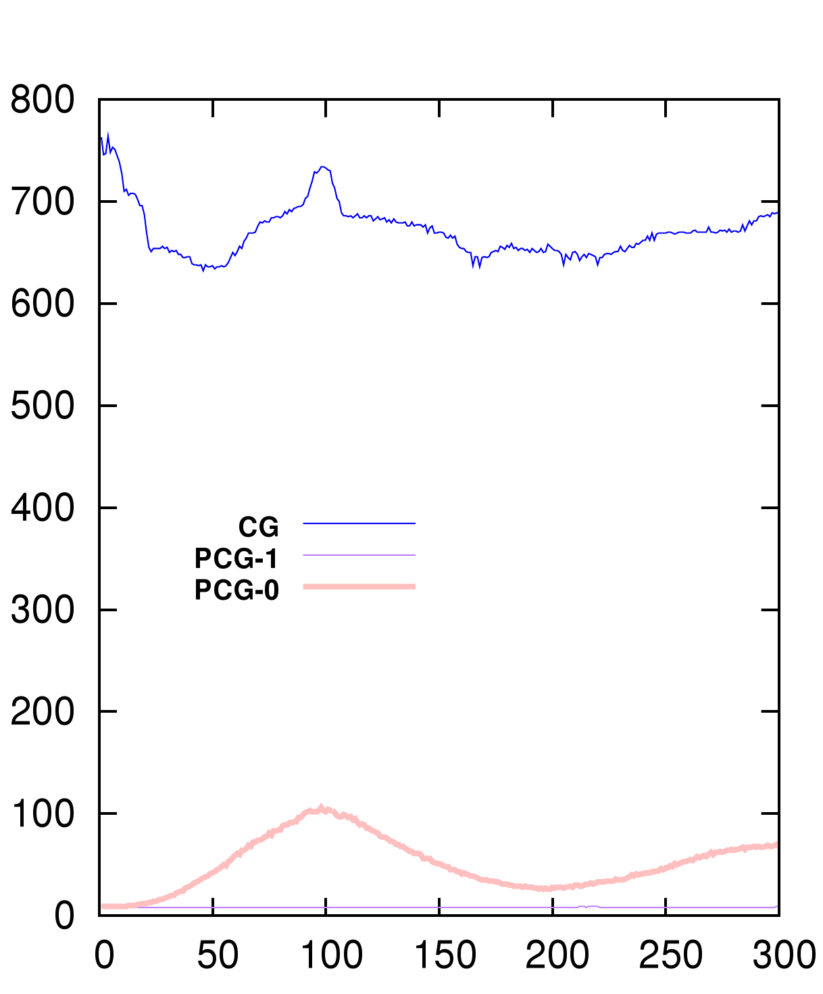
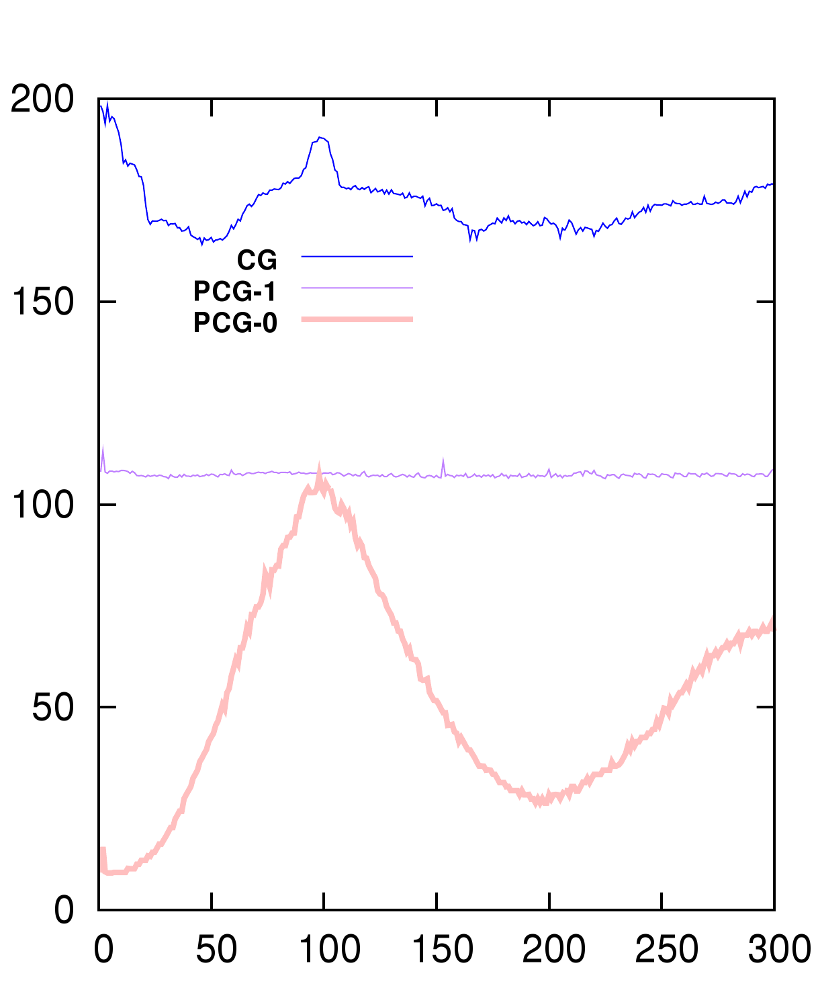
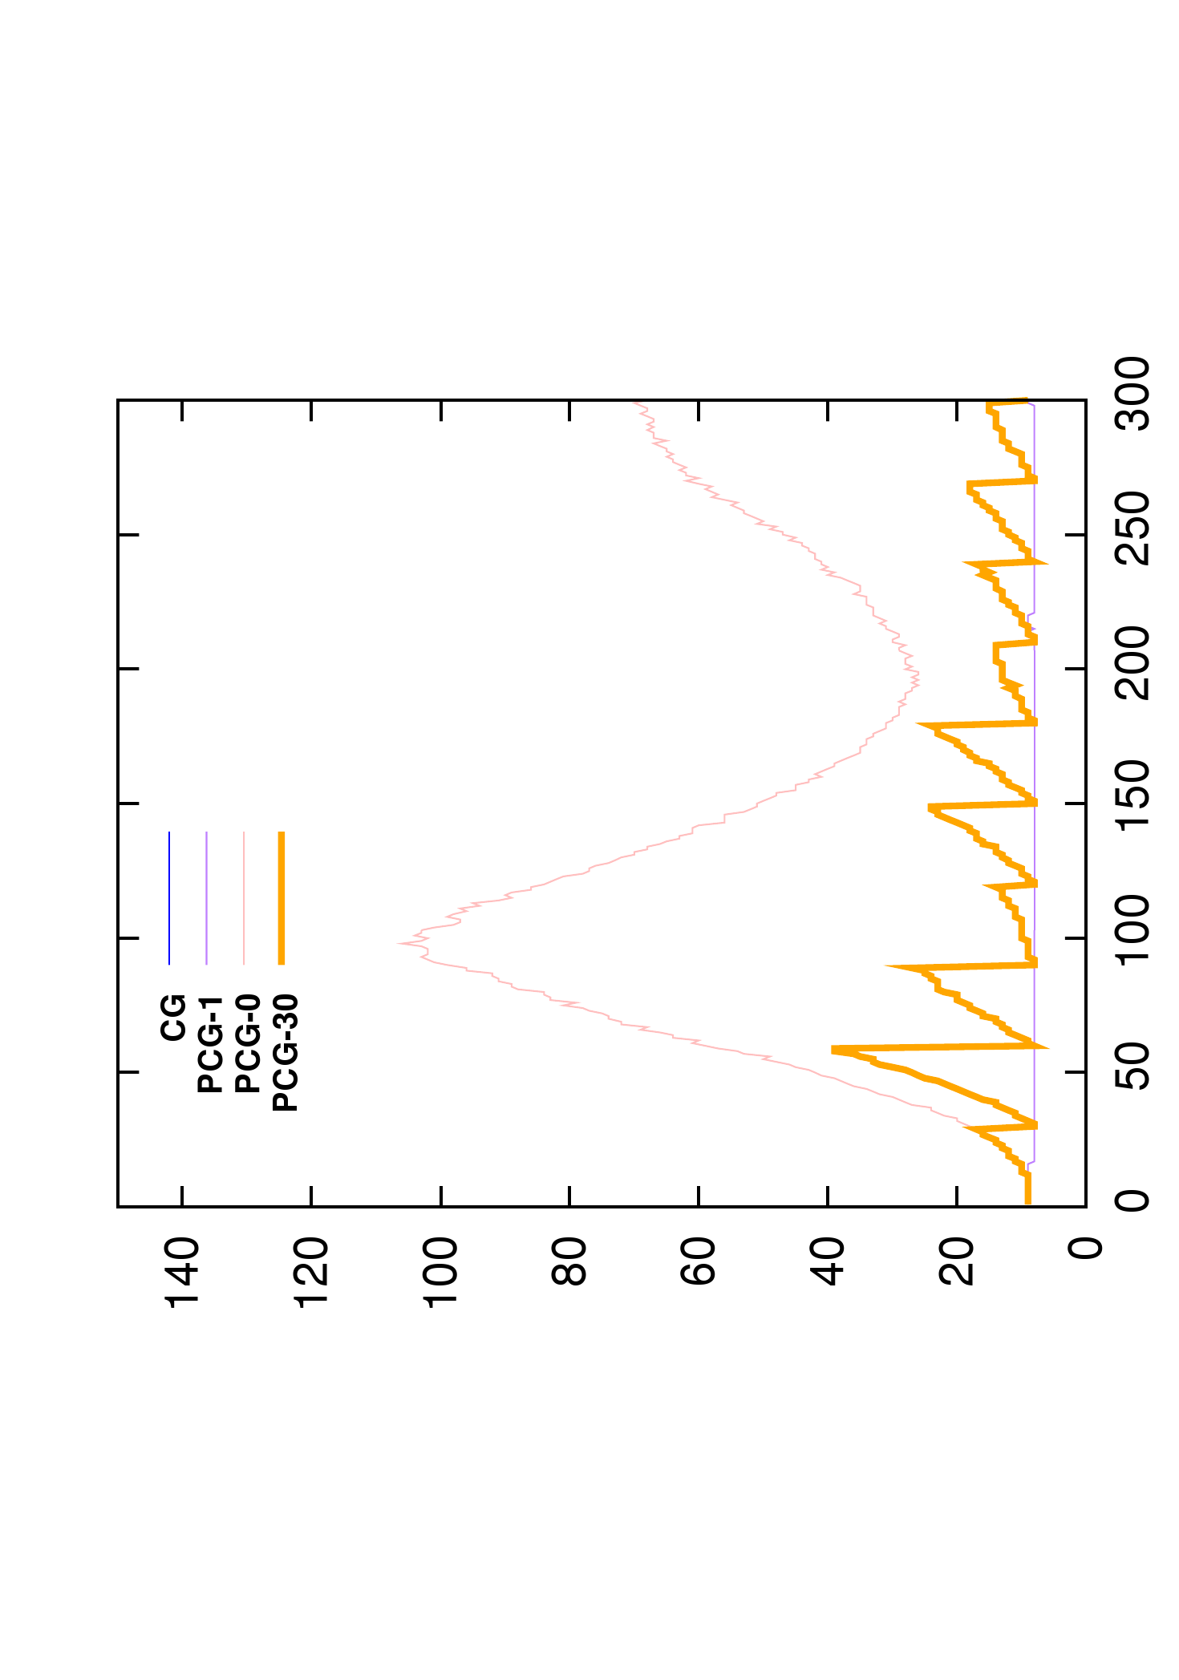
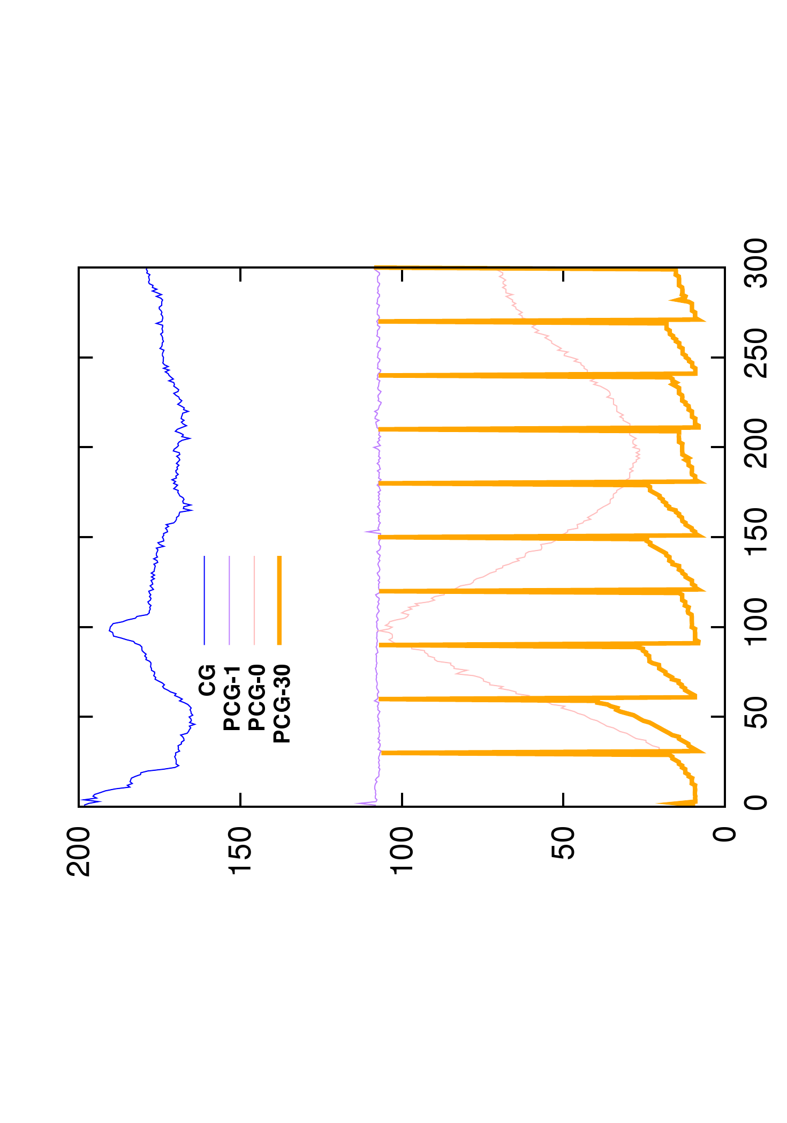
Asynchronous preconditioner
Number of iterations
Computation time (ms)

Slide 26
Asynchronous preconditioner
GPU-Base Conjugate gradient :
Simulate thousand of elements in real-time
High number of iterations for ill conditioned problems
Non homogeneous objects / Non uniform meshes
Use a preconditioner :
Approximation of the system which is easier to invert
New FEM Computation
Synchronization
Precond
Computation
$$A x=$$
$$b$$
$P^{−1} P^{−1}$
$$≈I$$
Fast convergence with additional overheads
Overhead to inverse the preconditioner
Overhead to apply the preconditioner at each iteration
Exploit time coherency between time steps
Enable to use advanced preconditioners :
Use an exact factorization of the system $P=LDL^{T}$
$L$ remains sparse and can be applied to detailed meshes
CG
Iterations
Precond
Application

Slide 27
Temporal system evolution
Step
Step
Step
Step
Step
Step
Step
Step
Step
time
Step
time
Each step requiers to solve a linear system $Ax=b$ (due to non linearities)

Slide 28
Asynchronous Preconditioner
$$Compute{ P}_{0 }$$
Step
time
First, we precompute the factorization of the system $P_{0}=A_{0}={L_{0}D}_{0}L_{0}^{T}$

Slide 29
Asynchronous Preconditioner
U$se P_{0}$
Step
Step
Step
Step
Step
time
$$Compute{ P}_{1 }$$
We use $P_{0}$ as preconditioner for the following steps, and in parallel we compute the next preconditioner ${ P}_{1}={ A}_{1}={L_{1}D}_{1}L_{1}^{T}$

Slide 30
Asynchronous Preconditioner
U$se P_{0}$
U$se P_{1}$
Step
Step
Step
Step
Step
time
$$Compute{ P}_{1 }$$
As soon as $P_{1}$ is available, we swap pointers to use $P_{1}$ for the following time steps

Slide 31
Asynchronous Preconditioner
U$se P_{0}$
U$se P_{1}$
Step
Step
Step
Step
Step
Step
Step
Step
Step
Step
time
$$Compute{ P}_{1 }$$
$$Compute{ P}_{2}$$
In parallel, we factorize the next preconditioner ${ P}_{2}={ A}_{2}={L_{2}D}_{2}L_{2}^{T}$

Slide 32
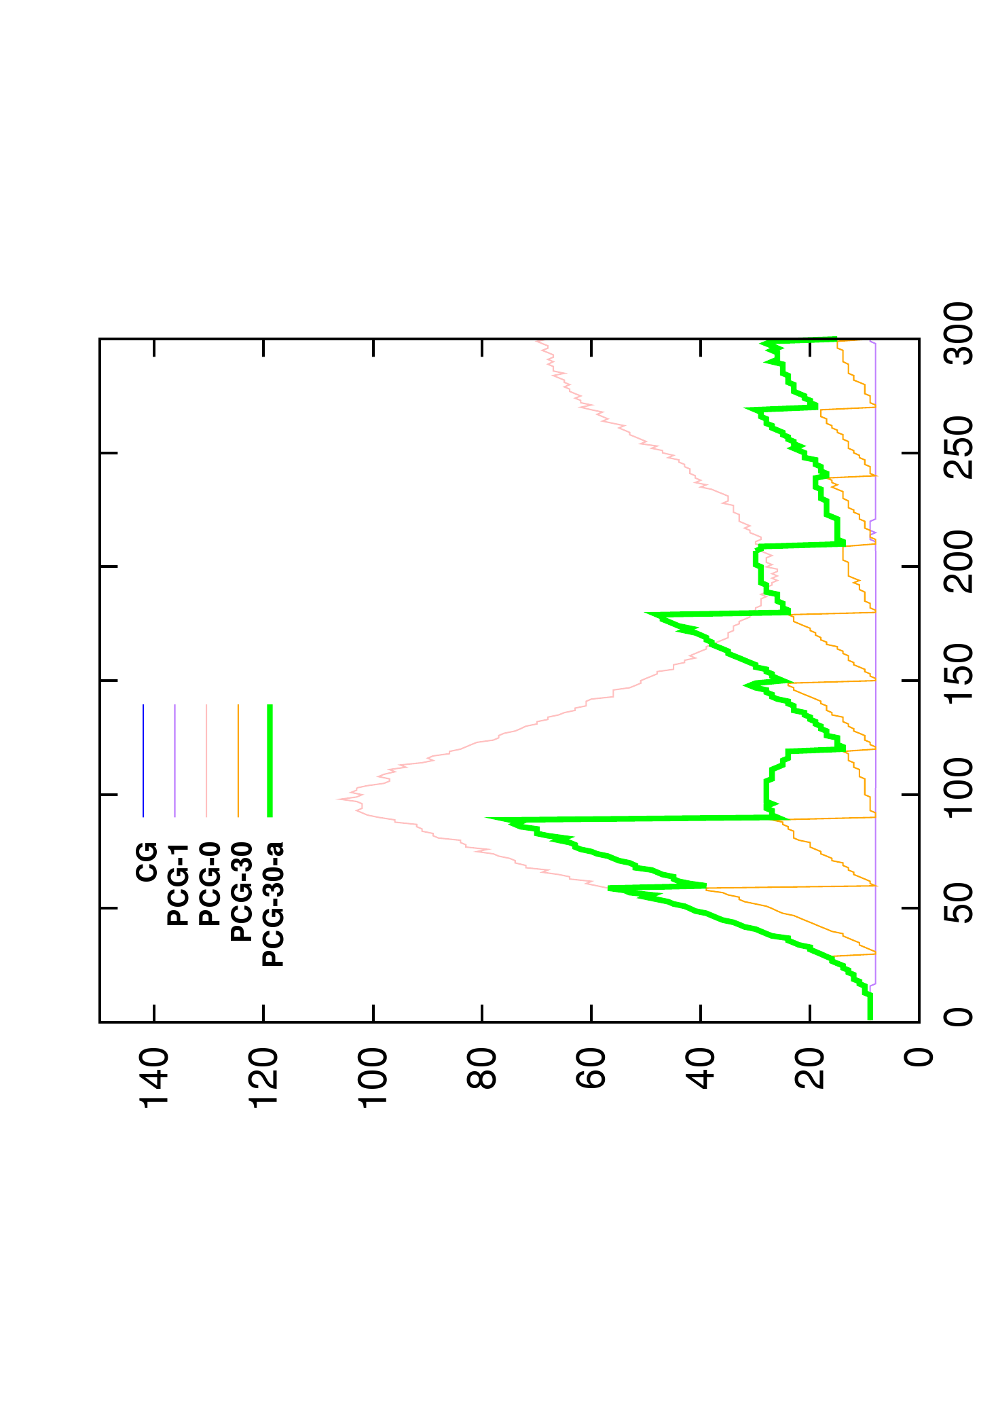
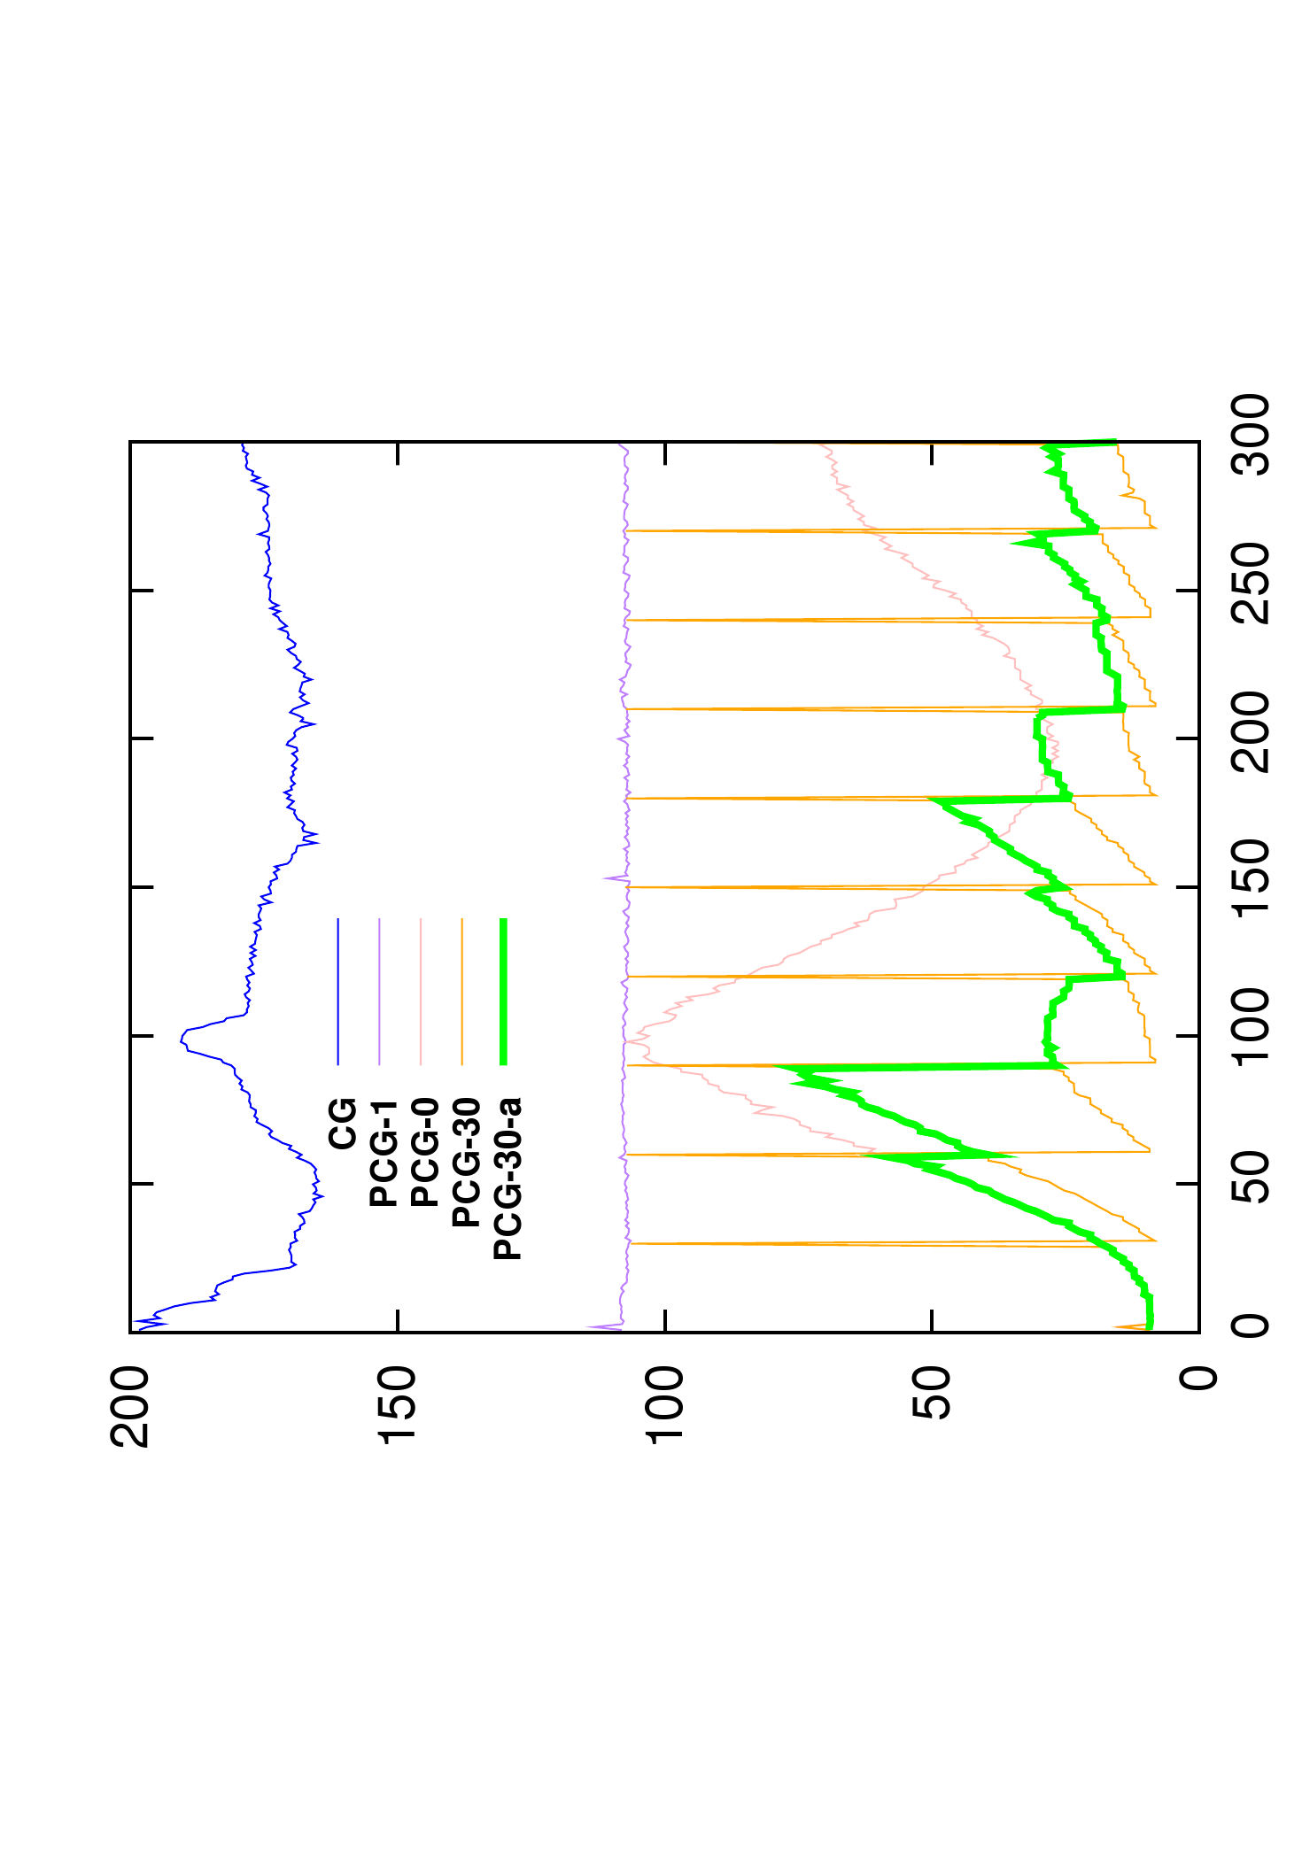
Asynchronous preconditioner
Number of iterations
Computation time (ms)

Slide 33
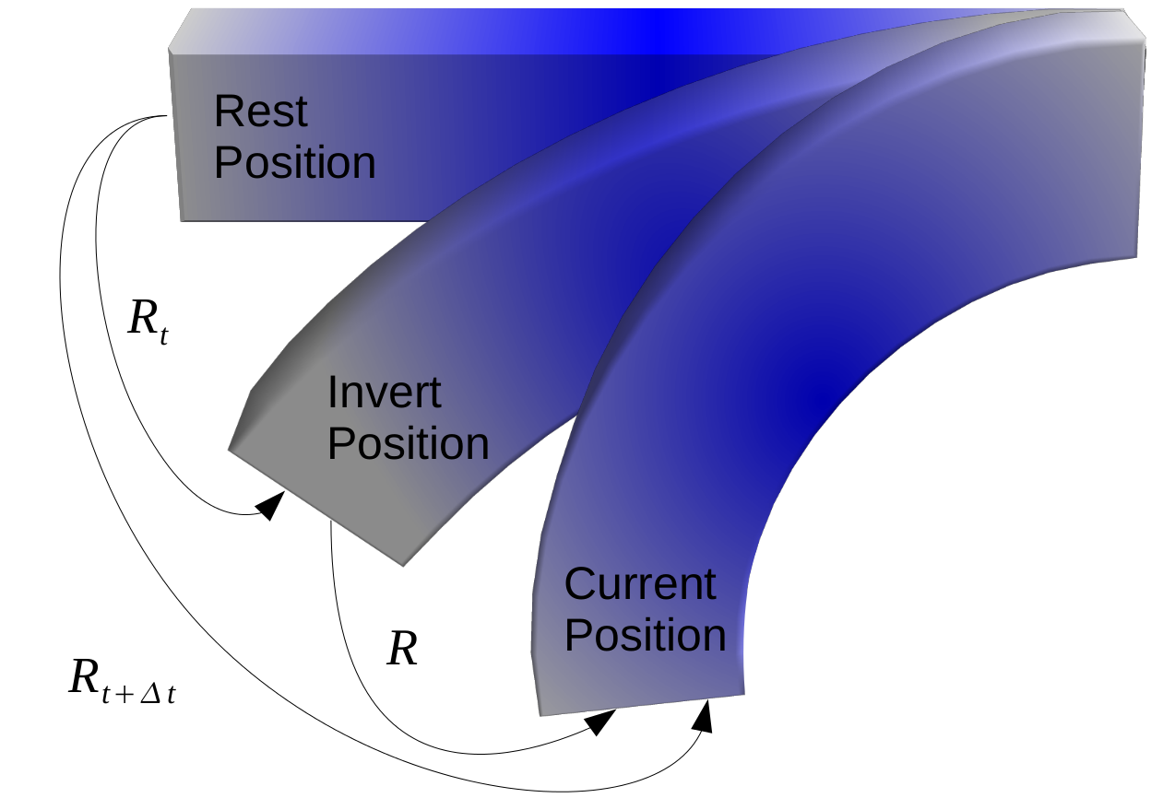
Asynchronous preconditioner
Heuristic to limit the divergence of the préconditionneur :
Apply rotation which appears since the last update of the preconditioner
Limit the effect of geometrical non linearities

Slide 34
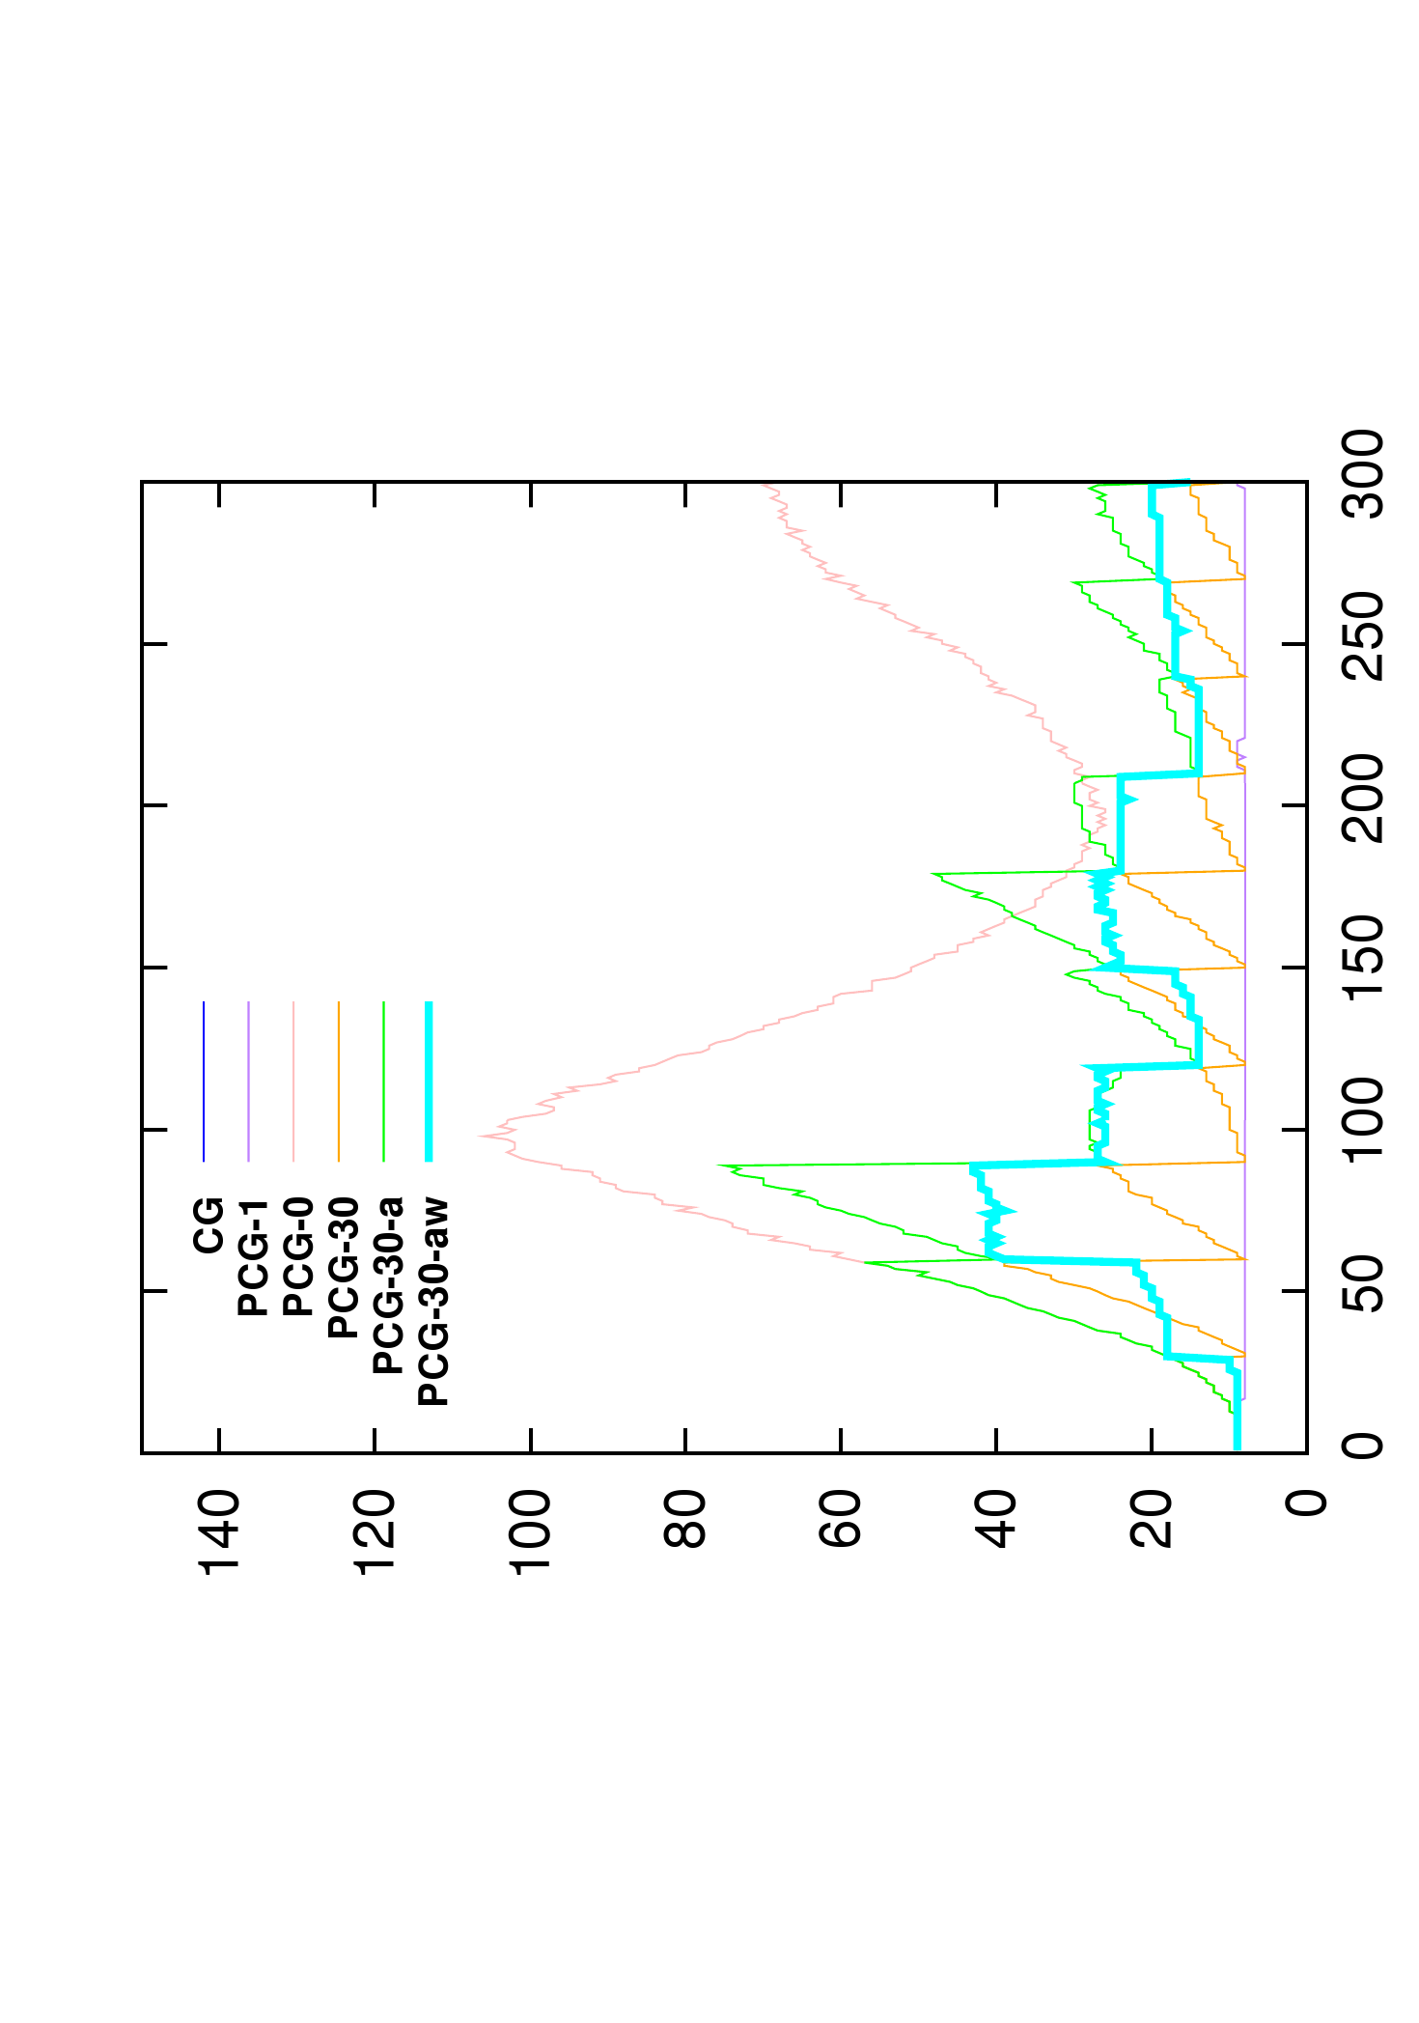
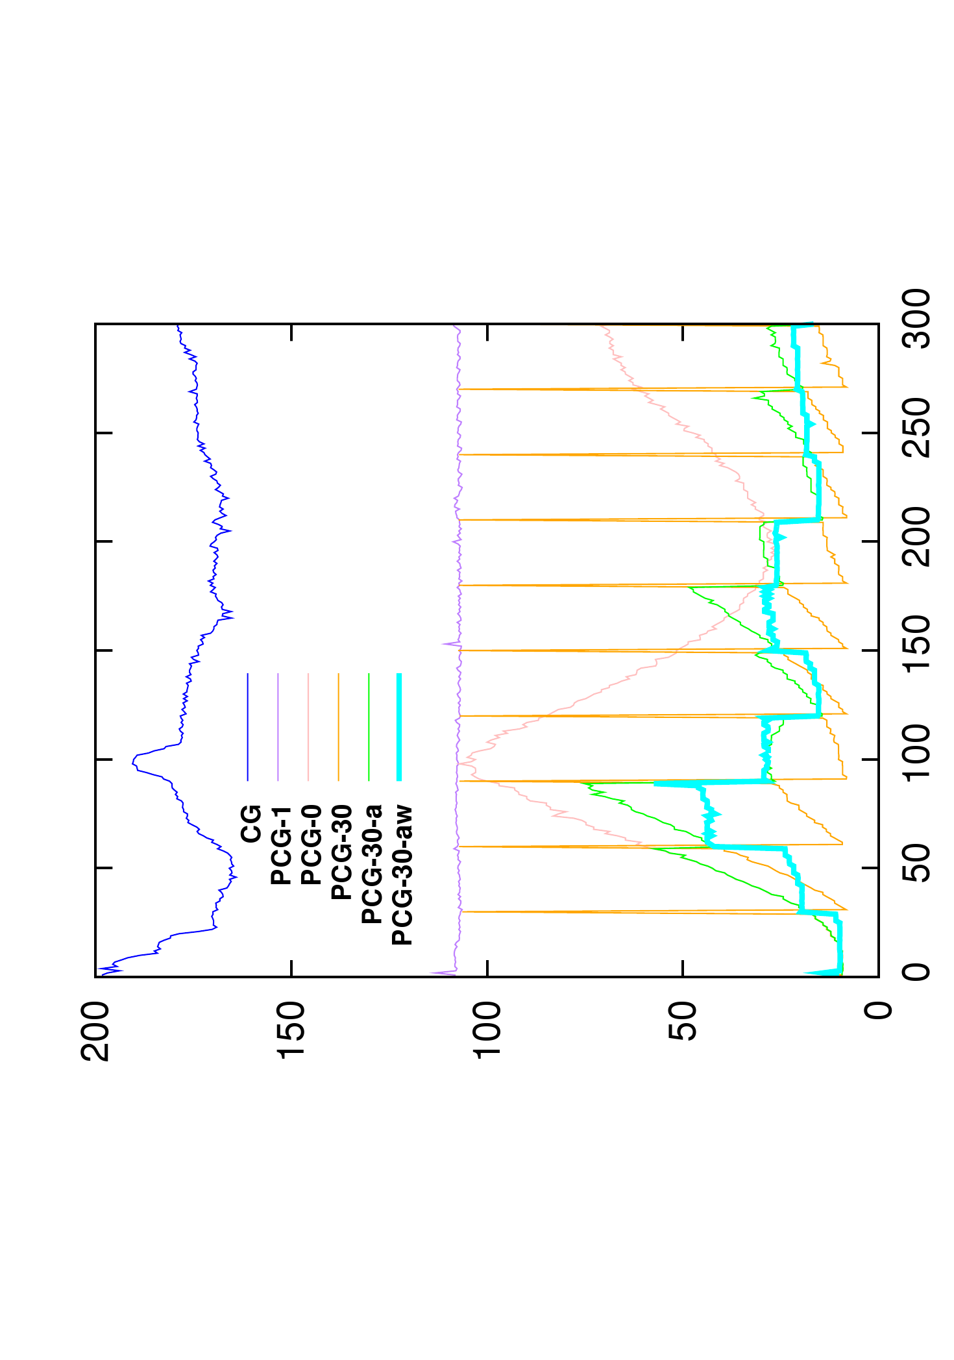
Asynchronous preconditioner
Number of iterations
Computation time (ms)

Slide 35
Asynchronous preconditioner
Heuristic to limit the divergence of the préconditionneur :
Apply rotation which appears since the last update of the preconditioner
Limit the effect of geometrical non linearities
Update the preconditioner as soon as possible :
The computation of the preconditioner is completely hidden from the simulation point of view.
With an optimized library, few time steps of simulation are necessary to update the preconditioner.

Slide 36
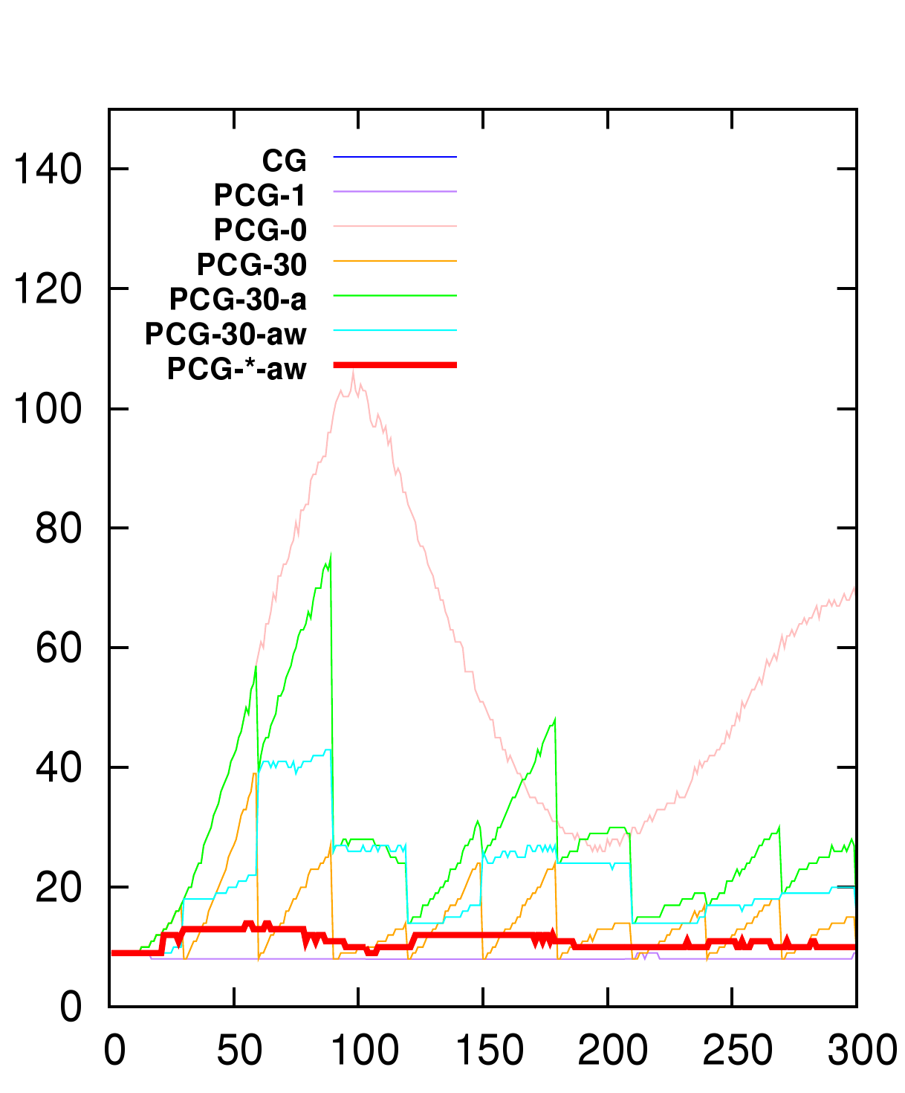
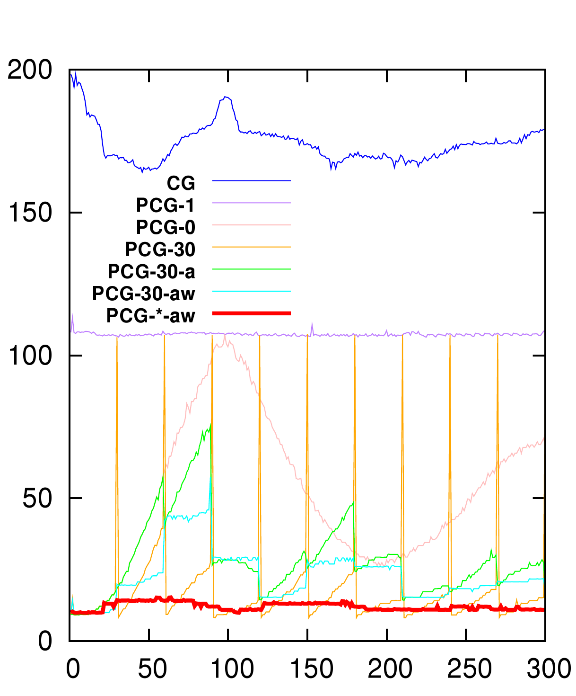
Asynchronous preconditioner
Number of iterations
Computation time (ms)

Slide 37
1
Overview and theoretical bases
2
GPU parallelization and Cuda
3
Preconditioners and asynchronous solvers
Asynchronous solvers for contact
5
Applications
4

Slide 38
Collision response
Signorini law to build a LCP (Linear Complementary Problem)
$= {(\frac{1}{h²}M+\frac{1}{h}B+K)}^{−1} +$
avec $0≤ δ⊥λ≥0$
$$H H^{T}$$
$$δ δ_{0}$$
$$λ$$
$H$ is the jacobian of contacts (sparse)
$δ$ is a measure of the interpenetration
λ is the contact force
${(\frac{1}{h²}M+\frac{1}{h}B+K)}^{−1}$ is the compliance matrix
dt=0,01

Slide 39
Preconditioners for contacts
The Compliance matrix is only a scaled version of the inverse of the system
$$H {(\frac{1}{h²}M+\frac{1}{h}B+K)}^{−1}H^{T} h² H$$
$$≈ {\left(LDL\right)}^{−1}$$
$$= { A}^{−1}$$
$$H^{T}$$
Reuse the préconditionneur to solve contacts [Courtecuisse et al. 2011, MICCAI]
However, we don’t have ${ A}^{−1}$but it’s factorization
$$H^{T}$$
We know how to apply the preconditionneur :
$Solve$ $\left(LDL x=b\right) \overset{⇔}{ } x= {(LDL)}^{−1}b$
We repeat this operation until we get $S= {(LDL)}^{−1}H^{T}$
Finally we get the compliance matrix with:
LDL
$$S$$
$${H (LDL)}^{−1}H^{T}=H S$$
($H$ is sparse)
$$H$$
Compliance

Slide 40
GPU parallelization
The most time consumming task is the compuation of $S$
Each column can be computed in parallel
GPU
Multiprocessor
Multiprocessor
Multiprocessor
Multiprocessor
Multiprocessor
Multiprocessor
Thread
(0,0)
Thread
(0,1)
$$H^{T}$$
$$H^{T}$$
$$H^{T}$$
$$H^{T}$$
$$H^{T}$$
$$H^{T}$$
Thread
(1,0)
Thread
(1,1)
LDL
S
LDL
S
LDL
S
LDL
S
LDL
S
LDL
S
Thread
(2,0)
Thread
(2,0)
Each resolution is computed by a single multiprocessor
A second level of parallelism is used inside each resolution
Well suit to GPU architectures
Only use local synchronisations

Slide 41
Validation of the method
Compare the positions with different approximations of the Compliance
The green shape represent the exact solution
The object is non homogeneous : Red tetrahedra are stiffer than blue ones
With Asynchronous update of the preconditioner, we get almost the correct solution
The green part and the blue part overlap perfectly
dt=0,01
Compliance
Warping
dt=0,01
Update every 50 time steps
dt=0,01
Update every 20 time steps
dt=0,01
Update every 3 time steps on average

Slide 42
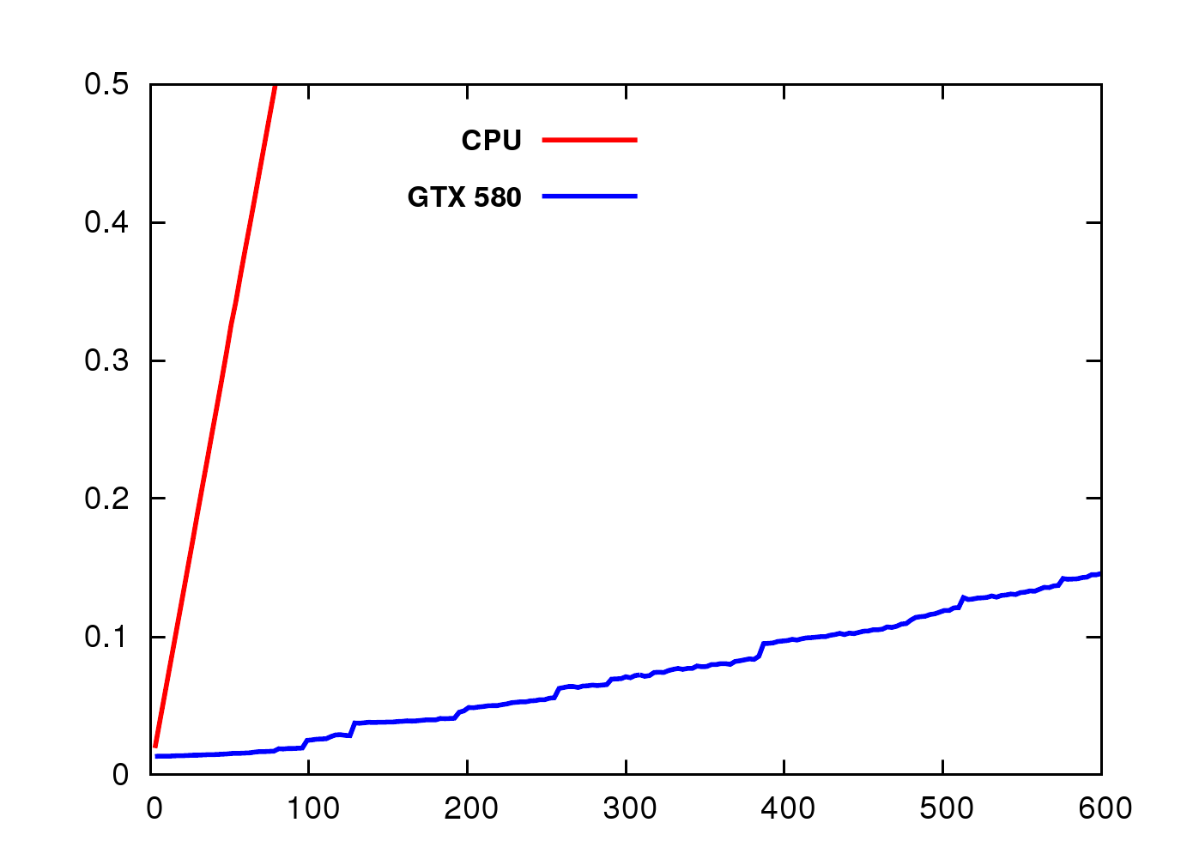
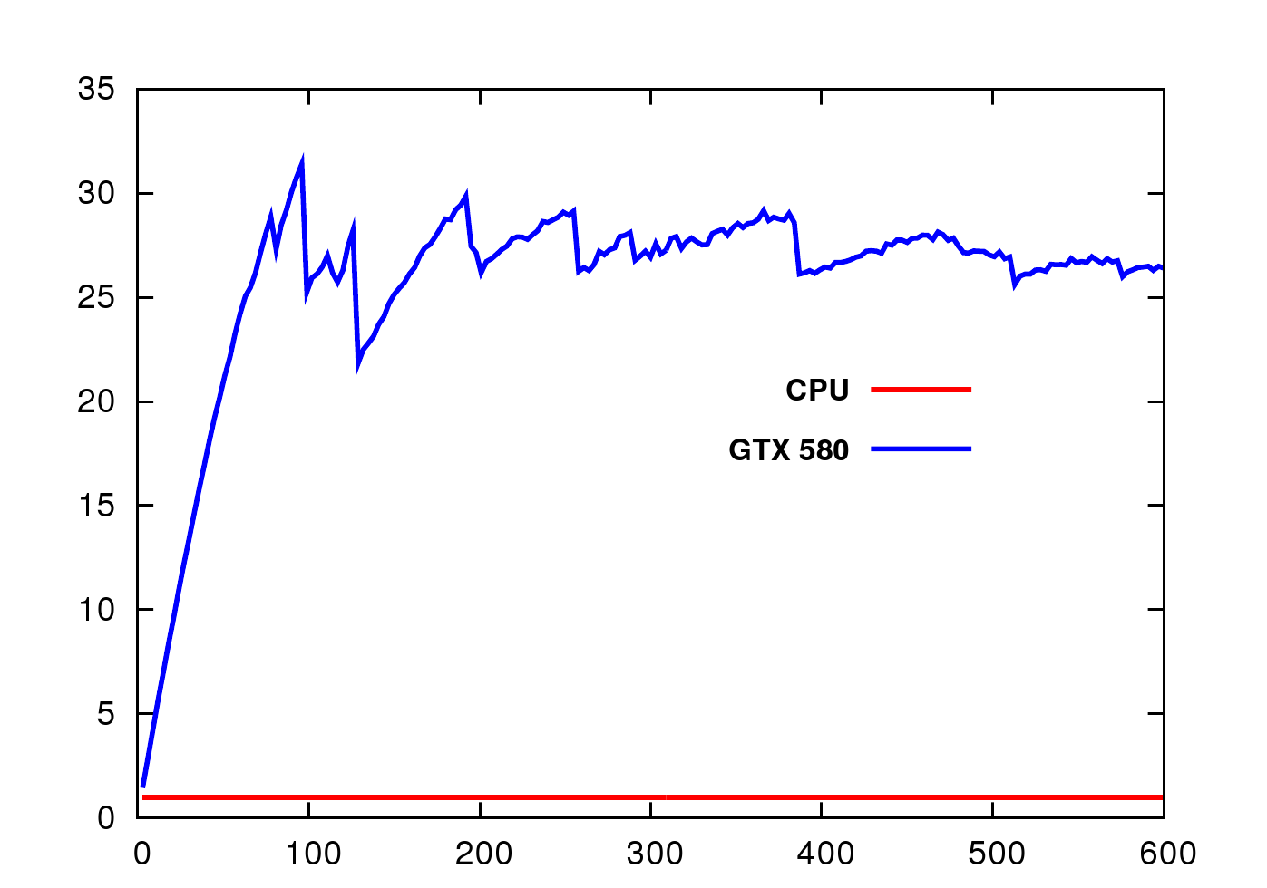
Computation time on GPU
With GPU implementation we can solve up to 128 constraints at the same cost
Real time computation is very limited on CPU (less than 10 constraints)
Enable to handle large number of contacts in real time on GPU
This method is well suit with LDI approach
Temps (sec)
Accélération
Nombre de Contraintes
Nombre de Contraintes

Slide 43
1
Overview and theoretical bases
2
GPU parallelization and Cuda
3
Preconditioners and asynchronous solvers
4
Asynchronous solvers for contact
5
Applications

Slide 47
Thank you for your attention

